Slide 1
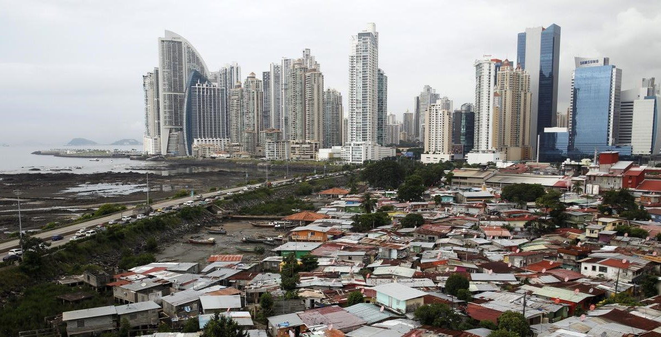

Health Inequality and Public Policy
(3)
Explanations of health inequality
Monday, 29. September 2025
Ass.-Prof. Dr. David Weisstanner
Faculty of Health Sciences and Medicine
University of Lucerne
Notes:
Last week: defining health inequalities; health inequalities vs inequities; absolute and relative measures; first descriptive indicators

Slide 2

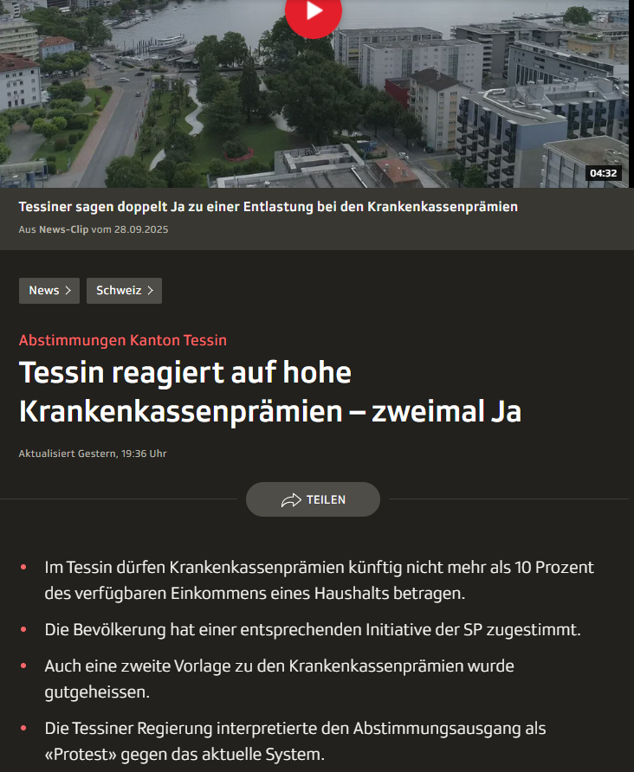
Current events
https://www.srf.ch/news/schweiz/abstimmungen-kanton-tessin-tessin-reagiert-auf-hohe-krankenkassenpraemien-zweimal-ja
https://www.facebook.com/blick/posts/pfbid02jKhVSndkouyCF9jz5zJxce8wyd165NVTZB8UzYFpgfXwxjPizikdRGs2EFeFp9y9l

Slide 3
Three main explanatory models
Behavioural explanations
Material explanations
Psychosocial explanations
Notes:
Applied part: items for these explanations. Also: mini evaluation, and information about research question.

Slide 4
(1) Health behaviours – not the whole story
Clear social gradient in most health-risk behaviours:
  Smoking 🟢
  Alcohol 🟠
        The “alcohol harm paradox”: social gradient in alcohol-related harm, despite similar consumption levels between low- and high-SES groups (Tolstrup et al. 2023)
  Diet 🟢
  Physical activity 🟢
  Unequally distributed health-risk behaviours explain some, but not all of health inequality
  Estimates on the contribution of health behaviours vary widely (from negligible to substantial)
  Largest contribution by smoking: median contribution of 19% to health inequalities (Petrovic et al. 2018)
  No simple “behavioural fix” of health inequality → instead increasing focus on how downstream risks develop over the life course and understand how they are shaped by upstream forces
  (Marmot: “the causes of the causes”)

Slide 5
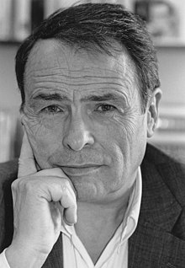
(1) Why Health behaviours are unequal
    «Ignorance»
      Lack of knowledge or understanding, lack of «health literacy»
      Very little evidence (e.g. Blaxter 1990)
    Culture
      Shared norms, learned dispositions, and everyday practices that shape what feels “normal” or acceptable (e.g. diet, smoking, activity)
    Status
      Behaviours and tastes used to signal social position and identity, marking boundaries between groups (e.g. “people like us don’t smoke / do yoga”)
Pierre Bourdieu

Slide 6
Examples – culture/Status
Mediterranean diet
“Another Round” (Danish: Druk, lit. ’Binge drinking’), released 2020
https://www.youtube.com/watch?v=40X5EX6Us7c
Notes:
Alcohol as both a collective cultural practice and a status/identity marker, with health consequences in the background.
Culture / Habitus: The film shows how drinking is deeply woven into Danish social life — celebratory, everyday, even ritualised (e.g. birthday parties, school traditions). Alcohol is a shared norm.
Status / Distinction: For the teachers, drinking becomes tied to ideas of confidence, creativity, and even professional identity. It’s not just about intoxication, but about performing a certain kind of self. In some scenes, it also marks belonging to a peer group.

Slide 7
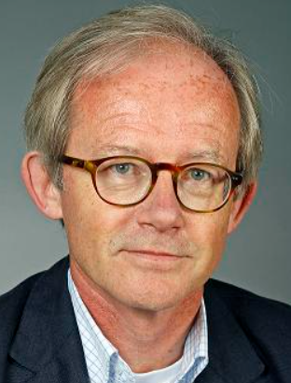
(1) Why Health behaviours are unequal
    «Ignorance»
      Lack of knowledge or understanding, lack of «health literacy»
      Weak evidence (e.g. Blaxter 1990)
    Culture
      Shared norms, learned dispositions, and everyday practices that shape what feels “normal” or acceptable (e.g. diet, smoking, activity)
    Status
      Behaviours and tastes used to signal social position and identity, marking boundaries between groups (e.g. “people like us don’t smoke / do yoga”)
    Personal characteristics / social selection
Pierre Bourdieu
Socio-economic position
«cognitive skills», «self control», «resilience», «intelligence», «personality», etc.
Personal
characteristics
Johan Mackenbach
Health
behaviour

Slide 8

(2) Materialist explanation
“the … diffuse consequences of the class structure: poverty, work conditions … and deprivation in its various forms in the home and immediate environment, at work, in education and the upbringing of children and more generally in family and social life” (Black, Morris and Townsend 1982: 134)
Materialist explanation: health inequalities arise because social class shapes people’s exposures and resources in everyday life, across many domains.
The Black Report (1982 edition)
Social class (social position) / Social structure
Material conditions (income/ poverty, work, housing/ environment)
Health risks
Inequalities that persist across the whole gradient

Slide 9
(2) Materialist explanation – Main pathways
Social class (social position) / Social structure
Material conditions (income/ poverty, work, housing/ environment)
Health risks
Inequalities that persist across the whole gradient
Income & poverty
  (Lack of) resources…
      …in absolute terms: money to “buy things” (food, housing, health care, etc.)
      …relative deprivation
Work & occupational exposures
  Dangerous, insecure, physically demanding jobs
  Exposure to chemicals, dusts, injuries
  Housing & living environment
  Cold, damp, mould
  Crowding
  Neighbourhood pollution/noise, traffic
Accumulation of risks
For example: low income + poor housing + hazardous work + polluted neighbourhood
Cumulative disadvantage across the life course
Power as a “fundamental cause”
Not just money: power to avoid risks, claim safer jobs, “life chances”
Stronger gradients

Slide 10

(3) Psychosocial factors
“the way social inequality makes people feel, and how these feelings may
themselves alter body chemistry” (Bartley & Kelly-Irving 2025: 112)
Wilkinson & Picket (2009): how inequality gets “under our skin”
Core idea: chronic stressors at home, at work, or in communities (e.g. social isolation, job strain, inequality) trigger psychological responses that alter biology via stress systems
  Evolutionary biological roots: responses to external threats (e.g. “fight-or-flight” response)
  “Allostatic load” → “the wear and tear on the body“ (McEwen 1998), the cumulative burden of chronic stress and life events → strong links to disease / health outcomes

Slide 11
(3) Main types of Psychosocial factors
Social support
      Supportive relationships from friends and relatives act as a “buffer” against other stressors
      Social connections, networks, integration in the community, “social capital” vs. loneliness, social isolation
Job strain
      High demand + low control at work
      → Theoretical link to the concept of “social class” (partly defined by job autonomy)
Effort-reward imbalance
      Feeling that progression in one’s job does not match the amount of effort put into it
      Feeling of lack of recognition of one's efforts
      Theoretical link to the concept of “social status” (prestige; beyond material deprivation)
Adverse childhood experiences (ACEs)
      E.g. household dysfunction, neglect, abuse
Notes:
Social capital is defined as the resources available to individuals through their social connections and community networks, characterized by the structure and quality of social relationships. It encompasses elements such as trust, norms, information channels, and appropriable social organizations.

Slide 12


Discussion: Policy implications
From the perspective of the three explanations (behavioural, materialist, psychosocial), which policy changes are most promising to reduce health inequalities?
POLICY WISHLIST
Strengthen health literacy
(Bevölkerungsrat 2025, most popular reform proposal)
Distribute healthcare financing more equitably
(Canton of Ticino: Limit health insurance premiums to 10%)
Reduce poverty and income insecurity via taxes & social benefits
Regulate employment and working conditions
Expand childcare benefits and parental leave
Provide decent housing & sustainable neighbourhoods
Raise taxes on tobacco, alcohol, and sugar
(Bevölkerungsrat 2025, more contested reform proposal)
Invest in education and lifelong learning
Promote community-based mental health services
Which policies would
you prioritise?
Can you justify your choice with one of the main health inequality theories (health behaviour, materialist, psychosocial)?
What mechanism does it target (e.g. reducing risky behaviours, improving material resources, reducing stress)?

Slide 13
Mini evaluation
What is going well?
What can I change / improve?
https://docs.google.com/forms/d/e/1FAIpQLScjmTqbnPLuJqc47nrwFacyfb3fm6XSKCxy5-0pv48IiTU0Iw/viewform?usp=sharing&ouid=116046000436575219118

Slide 14
Recap – purpose of the Applied part
  Using survey data to describe, compare, and explain health inequalities across countries & over time
      ISSP 2011 & 2021 “Health and Health Care” and ESS 7 & 11 “Social Inequalities in Health”
  Develop an own empirical project using ISSP or ESS data
      Motivation: practicing core academic skills, implement an own empirical research project from A-Z
        Apply basic survey research methods, data management, analytical strategies, etc.
        Practice with the datasets in class, give & receive feedback on your projects
        Not a methods course – focus on applying methods (at any level of methodological training)
  Written paper due on 29th January 2026
      Presentations on 24th November or 1st December
      Outline/preliminary draft of your projects due 1 week before the presentation (not graded)
      Opportunity for 1:1 feedback meetings before or after your presentation (scheduled on request)
      Homework for next week (6th October): write down a potential topic / research question(s)
      Next week in class, we will discuss criteria to develop a well-specified research question and provide peer feedback on each other’s research question ideas

Slide 15
Using chatgpt to get Ideas for research questions
🔍 Possible Student Paper Research Questions (ESS / ISSP)
1. Health behaviours explanation
How large is the income gradient in smoking, heavy drinking, diet, or physical activity across European countries?
Does the “alcohol harm paradox” appear in ESS data (i.e. similar consumption but worse health among low-income groups)?
How do levels of health literacy (knowledge, attitudes, trust in health info) vary by education and SES?
2. Materialist explanation
How strongly are income, housing quality, and employment insecurity associated with self-rated health? Do these associations differ across welfare regimes (e.g. Nordic vs. Southern Europe)?
Is poverty or income inequality within a country more strongly linked to health inequality?
Do differences in occupational class explain part of the self-rated health gradient even after controlling for income?
3. Psychosocial explanation
To what extent does social isolation, loneliness, or low social trust explain inequalities in self-rated health?
Are people in low-control jobs (measured by autonomy, decision-making) more likely to report poor health?
Is there evidence that perceived unfairness or low social status predicts worse health outcomes beyond material conditions?
4. Cross-cutting / policy-relevant
How much of the SES gradient in health is explained by behaviours vs. material conditions vs. psychosocial stressors? (students could test mediation models).
Are health inequalities smaller in countries with stronger welfare states (high redistribution, generous family policies)?
Do subjective beliefs about the causes of health inequality (e.g. individual responsibility vs. structural causes, ISSP modules) shape support for redistributive health policies?
How do attitudes toward smoking bans, sugar taxes, or healthcare provision vary by income and health status?
Caution: Many of these need refinement (some are purely descriptive, others are not specific enough or have no clear link to the availabe variables).
But can be useful to get ideas for potential research questions…

Slide 16
Applied part – ISSP/ESS datasets
Milestones so far: getting started (week 1) ✅, first descriptive health inequality indicators (week 2) ✅
Milestone today: Find items for behavioural, material, and psychosocial explanations in the ISSP/ESS
Task: Create an overview of the most relevant variables to test the behavioural, material, and psychosocial explanations of health inequality.
Class divided in four groups, each looking at one of the four datasets (ISSP 11/21, ESS 7/11)
Every group works in one Google document:
  ESS 7 link
  ESS 11 link
  ISSP 2011 link
  ISSP 2021 link
  Present the available items
  Task 2 (optional/if time allows): pick one or two key variables linked to a theory of health inequality, and analyse if there is a social gradient in these variables

Slide 17
Outlook next week
4 06.10.2025 Health inequality attributions
Focus on perceptions – how people explain the social gradient in health
Reading: Baute, S. (2025). ‘Health Inequality Attributions and Support for Healthcare Policy’.
Social Science & Medicine: 117946.
Applied focus: ISSP items on causes of health problems and stigma attributions
      Homework for next week: write down a potential topic / research question(s)
      Next week in class, we will discuss criteria to develop a well-specified research question and provide peer feedback on each other’s research question ideas

Slide 18
References
Bartley, M., & Kelly-Irving, M. (2025). Health Inequality. An Introduction to Concepts, Theories and Methods (3rd ed.). Polity Press.
Mackenbach, J. P. (2019). Health Inequalities. Persistence and Change in European Welfare States. Oxford University Press.
McEwen, B. S. (1998). Stress, Adaptation, and Disease: Allostasis and Allostatic Load. Annals of the New York Academy of Sciences, 840(1), 33–44. https://doi.org/10.1111/j.1749-6632.1998.tb09546.x
Petrovic, D., de Mestral, C., Bochud, M., Bartley, M., Kivimäki, M., Vineis, P., Mackenbach, J., & Stringhini, S. (2018). The contribution of health behaviors to socioeconomic inequalities in health: A systematic review. Preventive Medicine, 113, 15–31. https://doi.org/10.1016/j.ypmed.2018.05.003
Tolstrup, J. S., Kruckow, S., Becker, U., Andersen, O., Sawyer, S. M., Katikireddi, S. V., & Møller, S. P. (2023). Socioeconomic inequalities in alcohol-related harm in adolescents: A prospective cohort study of 68,299 Danish 15–19-year-olds. eClinicalMedicine, 62. https://doi.org/10.1016/j.eclinm.2023.102129

